Slide 1
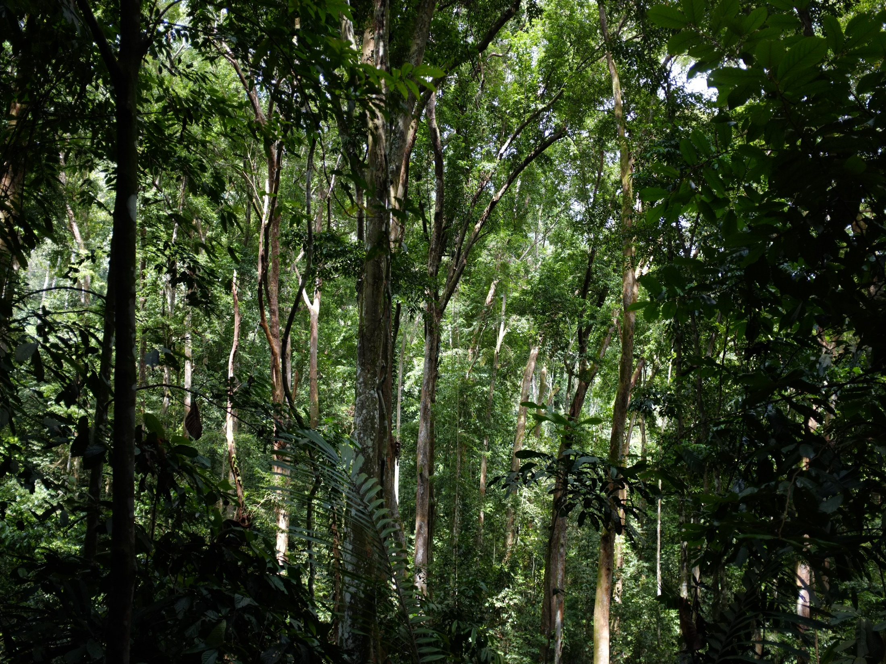

LANDSCAPE-BASED RESTORATION
MOBILIZING COMMITMENT FOR BONN CHALLENGE
NIRARTA (KONI) SAMADHI | PARIS, 1 DECEMBER 2015

Slide 2
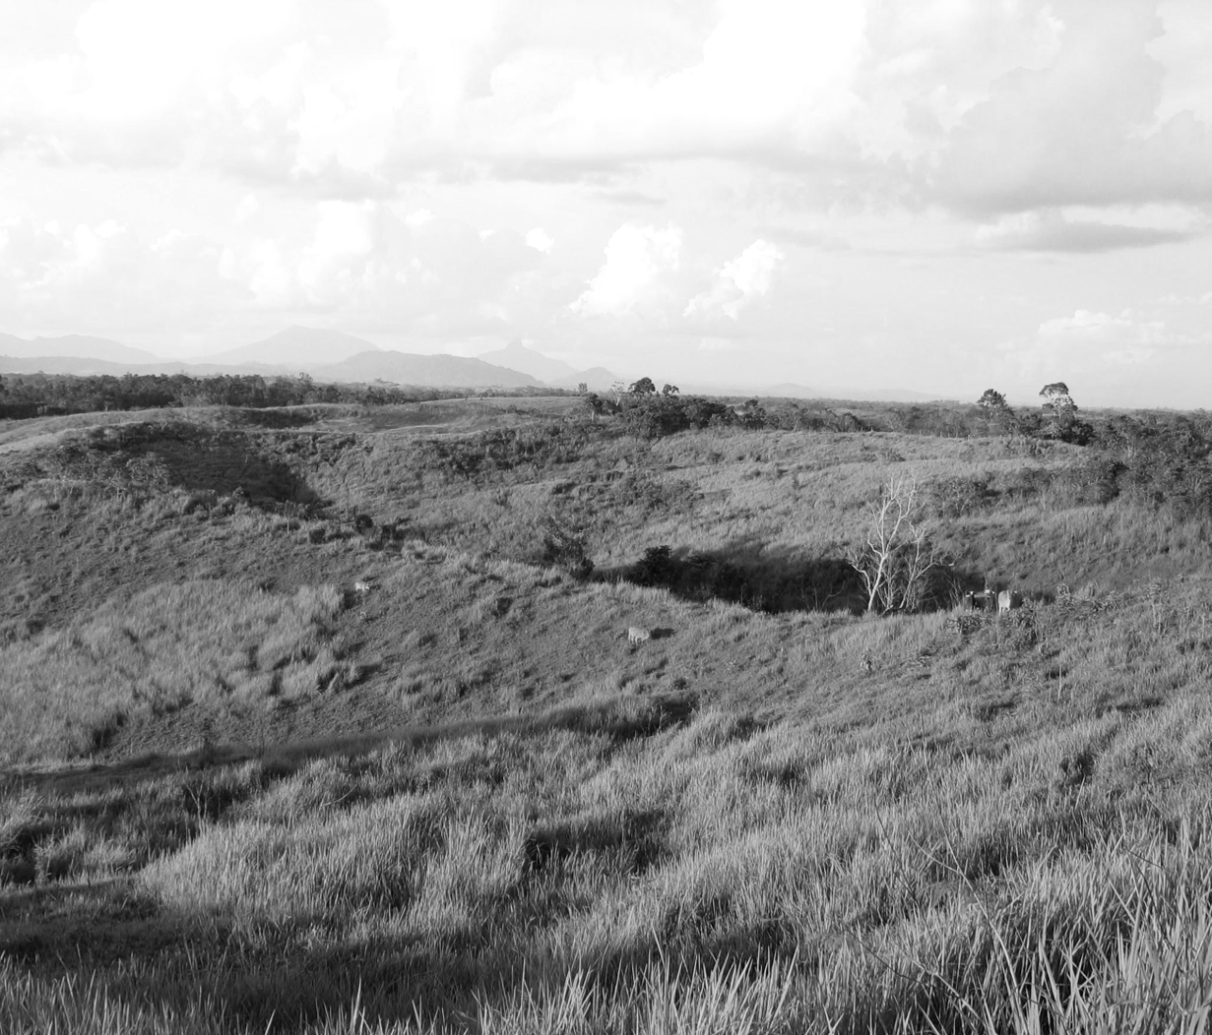








CHALLENGES AND CURRENT SITUATION
POPULATION GROWTH
INCREASING DEMAND FOR COMMODITIES
MORE LAND NEEDED FOR AGRICULTURES
INCREASING DEFORESTATION
1. INCREASING PRESSURES ON LAND
2. DECREASING UTILIZATION OF LAND
3. THE POOR ARE DISPROPORTIONATELY AFFECTED
Notes:
1. Link to GHG emission & RAN-GRK (as next step of the problem)

Slide 3
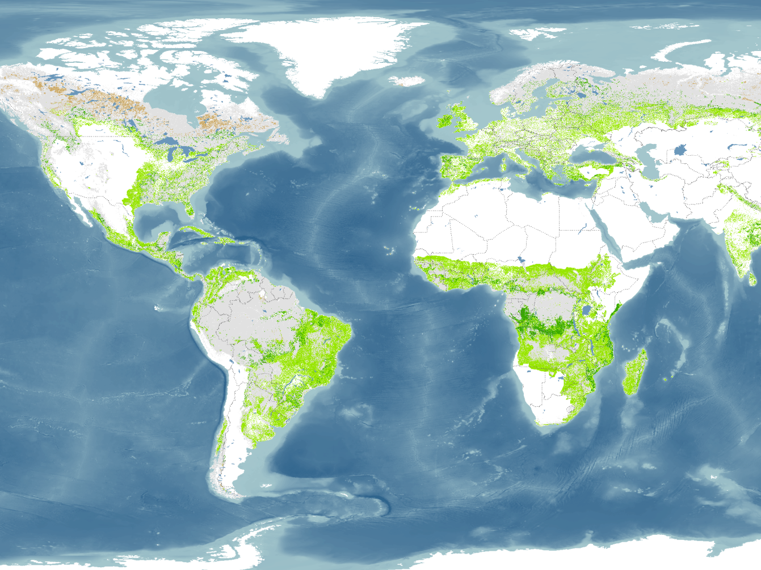
GLOBAL RESTORATION OPPORTUNITY MAP
2bn
hectares with opportunities for restoration

Slide 4
GLOBAL RESTORATION OPPORTUNITY MAP
BUT THIS IS NOT GRANULAR ENOUGH FOR NATIONAL-LEVEL ASSESSMENT

Slide 5
NON-FORESTED
PLANTATION FORESTS
SECONDARY FOREST
HUTAN PRIMER
LAND COVER & LEGAL STATUS STATISTICS
Source: Statistik Kehutanan 2013, Kementerian Kehutanan Republik Indonesia
Hasil penafsiran citra Landsat 7 ETM+ liputan tahun 2012, Direktorat Inventarisasi dan Pemantauan Sumber Daya Hutan
Notes:
1. Link to GHG emission & RAN-GRK (as next step of the problem)

Slide 6
NON-FORESTED
29 mil Ha non-forested area within forest estate
Not allowed to be used for non-forestry activities
PLANTATION FORESTS
SECONDARY FOREST
HUTAN PRIMER
14 mil Ha forested area within non-forest estate
Prone to be deforested and converted to non-forest land
Source: Statistik Kehutanan 2013, Kementerian Kehutanan Republik Indonesia
Hasil penafsiran citra Landsat 7 ETM+ liputan tahun 2012, Direktorat Inventarisasi dan Pemantauan Sumber Daya Hutan
Notes:
1. Link to GHG emission & RAN-GRK (as next step of the problem)

Slide 7
NON-FORESTED
PLANTATION FORESTS
SECONDARY FOREST
HUTAN PRIMER
CONSERVATION EFFORTS
Source: Statistik Kehutanan 2013, Kementerian Kehutanan Republik Indonesia
Hasil penafsiran citra Landsat 7 ETM+ liputan tahun 2012, Direktorat Inventarisasi dan Pemantauan Sumber Daya Hutan
Notes:
1. Link to GHG emission & RAN-GRK (as next step of the problem)

Slide 8
NON-FORESTED
PLANTATION FORESTS
SECONDARY FOREST
HUTAN PRIMER
RESTORATION EFFORTS
?
Source: Statistik Kehutanan 2013, Kementerian Kehutanan Republik Indonesia
Hasil penafsiran citra Landsat 7 ETM+ liputan tahun 2012, Direktorat Inventarisasi dan Pemantauan Sumber Daya Hutan
Notes:
1. Link to GHG emission & RAN-GRK (as next step of the problem)

Slide 9
Forestry and Agriculture (LULUCF) account for 87% of total GHG mitigation plan
National GHG
Mitigation Policies
Restoration related policies account for 60% of LULUCF
Source: Perpres 61/2011
Notes:
1. Link to GHG emission & RAN-GRK (as next step of the problem)

Slide 10
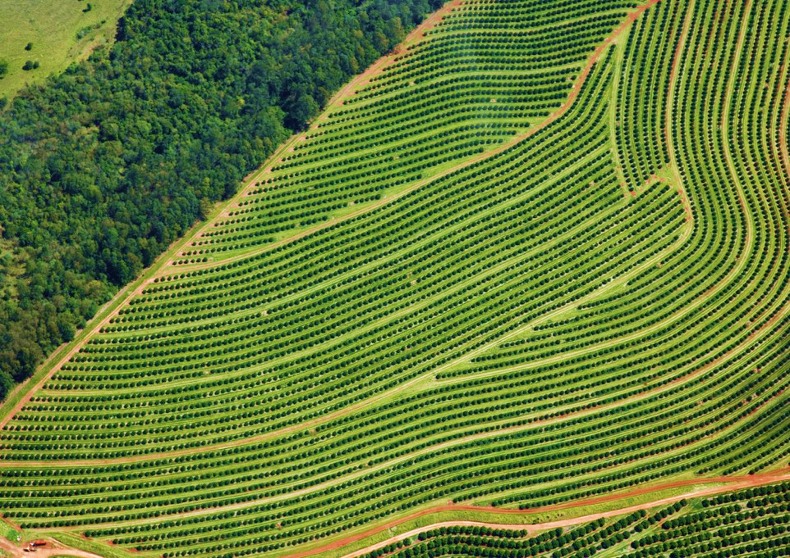
BUT FOCUSING ON JUST “MORE VEGETATION” WON’T BRING MORE BENEFIT TO THE LANDSCAPE AND COMMUNITIES
WHAT CONSTITUTES A RESTORATION?

Slide 11
FORESTS AND LANDSCAPE RESTORATION
ARE NOT JUST AFORESTATION OR REFORESTATION
CURRENT CONDITION
AGRICULTURE-FARMING
AGRO-FORESTRY
FORESTS ARE BEING CONVERTED INTO AGRICULTURE/FARMING LANDS
DEGRADED LAND/ABANDONED LAND/CRITICAL LAND
FORESTS, AGRICULTURE, AND AGRO-FORESTRY LANDS ARE NOT MANAGED PROPERLY AND TURNED INTO DEGRADED LANDS
FOREST
WITH NO INTERVENTION, WE WILL HAVE MORE DEGRADED, UNPRODUCTIVE LANDSCAPE IN THE FUTURE

Slide 12
FORESTS AND LANDSCAPE RESTORATION
ARE NOT JUST AFORESTATION OR REFORESTATION
VISION FOR THE FUTURE
AGRICULTURE-FARMING
AGRICULTURE-FARMING
PRODUCTION INTENSIFICATION
AGRO-FORESTRY
DEGRADED LAND/ABANDONED LAND/CRITICAL LAND
AGRO-FORESTRY
LANDSCAPE
RESTORATION
FUNCTIONING & PRODUCTIVE LANDSCAPE
FOREST
FOREST
STOPPING DEFORESTATION

Slide 13

SPECTRUM OF FOREST & LANDSCAPE RESTORATION
POTICO
GLOBAL RESTORATION INITIATIVE
Mono-culture crop
Landscape crop land
Agroforestry
Reforestation
Ecosystem restoration
“A long-term process of regaining ecological functionality and enhancing human well-being across deforested or degraded forest landscapes.”

Slide 14
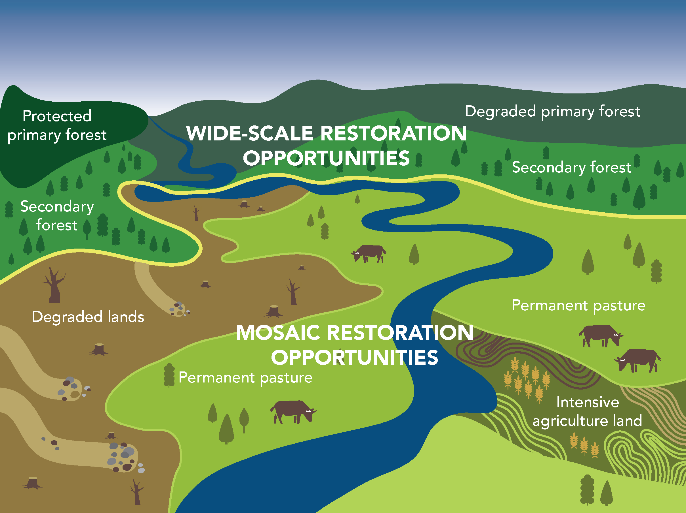
RESTORATION NEEDS TO BE APPROACHED BY
CROSS-SECTORAL, MULTI-STAKEHOLDERS, AND CROSS-JURISDICTION EFFORTS

Slide 15
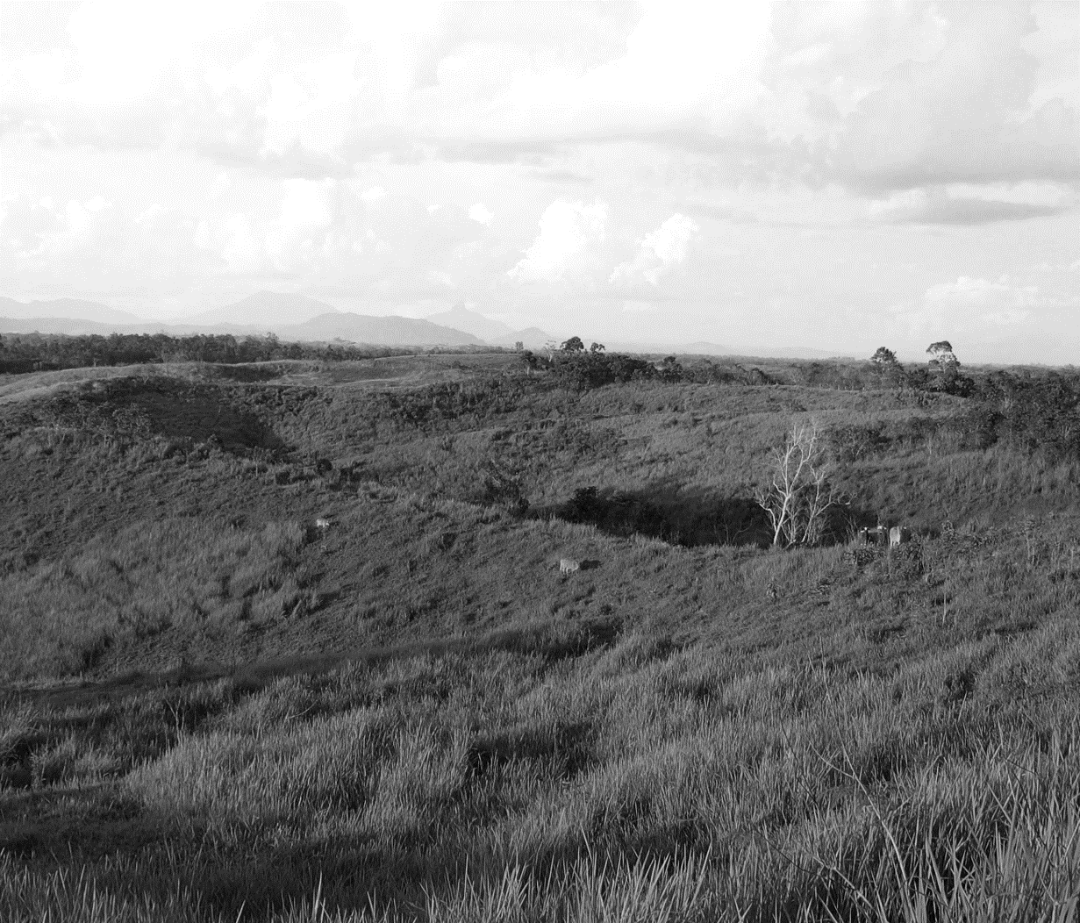
KEY QUESTIONS NEED TO BE ANSWERED TO DEVELOP
LANDSCAPE RESTORATION ROADMAP
How to identify restoration opportunities?
Where are the priority areas for restoration?
What type of restorations are suitable for each landscapes?
Who are the main decision makers & beneficiaries of restoration activities?
What policy instruments are needed to support restoration?

Slide 16
WHAT TO BE RESTORED?
7 million hectares of unused/abandoned degraded land (“tanah terlantar yang kondisinya sangat kritis”) according to Ministry of Forestry, February 2010.
12 million hectares of “idle land” the National Land Agency (BPN) indicates could be used for business purposes, according to the Forestry Minister (Jakarta Post 2010).
31 million hectares of “unused land” considered “suitable” and “available” for agriculture (Agricultural Research & Development Body 2007, cited in Indonesia’s draft REDD+ policy).
40 million hectares of “degraded forests” within the forest estate according to the Forestry Minister (Jakarta Post 2010).
55 million hectares of land designated as non-forest, in other words, land outside the forest estate (Ministry of Forestry 2008, cited in Indonesia’s draft REDD+ policy).

Slide 17






RESTOREplus — COLLECTIVE ENDEAVOUR
Identification degraded land through remote sensing and crowd verification
Biophysical and biodiversity consideration to define degraded land
Evidence based policy impact assessment through land-use modelling
Stakeholder engagement in restoration activities?
Agroforestry based sustainable agriculture measures
IIASA INPE WRI WWF ICRAF UNEP-WCMC

Slide 18




FORESTS & LANDSCAPE RESTORATION ROADMAP
FOREST & LANDSCAPE RESTORATION
FOOD & ENERGY SOVEREIGNTY,
DEGRADED LAND
IDENTIFICATION OF RESTORATION OPPORTUNITY
RAPID RESTORATION DIAGNOSTIC
SOCIAL SAFEGUARD
ENVIRONMENTAL SAFEGUARD
ECONOMIC FEASIBILITY
LEGAL COMPLIANCE
ECONOMIC BENEFIT FOR COMMUNITIES
ECOSYSTEM SERVICES RESTORED
ECOLOGICAL BENEFIT FOR LANDSCAPE ACHIEVED

Slide 19
LANDSCAPE-BASED RESTORATION
MOBILIZING COMMITMENT FOR BONN CHALLENGE
NIRARTA (KONI) SAMADHI | PARIS, 1 DECEMBER 2015

